Slide 1
MULTIVERSIDAD LATINOAMERICANA
CAMPUS: OAXACA URBANA
BACHILLERATO.
Materia: Lengua Adicional al Español I.

Slide 2
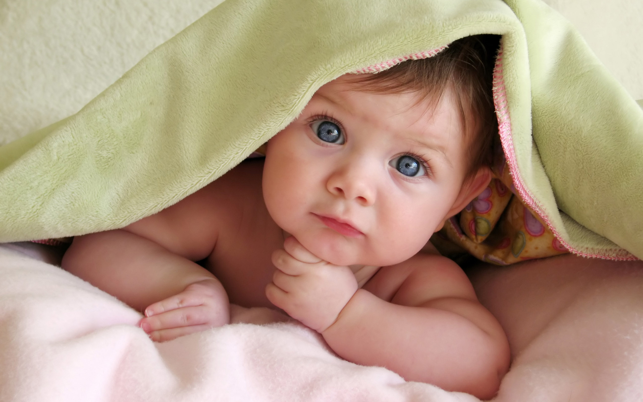
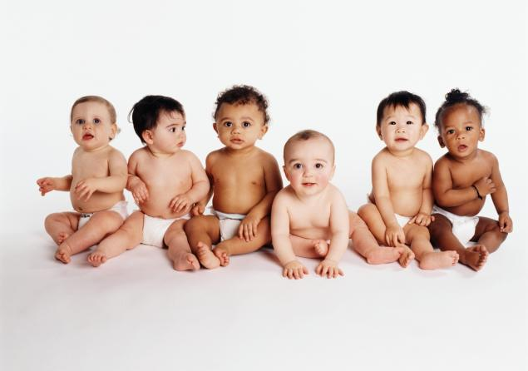
4.2 plural of nouns , special cases.
a) TO WORDS ENDING IN A CONSONANT FOLLOWED BY THE LETTER “Y”, CHANGE THE “Y” FOR AN “I” AND ADD ES
BABIES
BABY

Slide 3
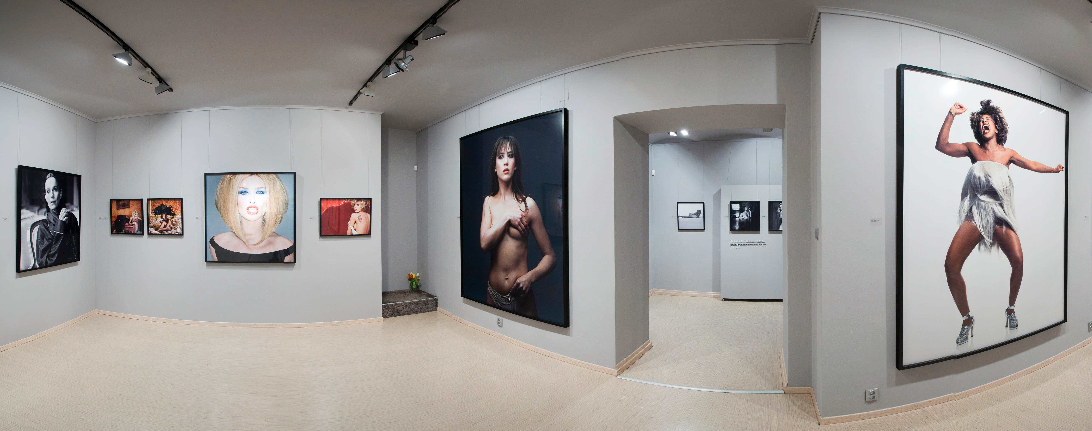
GALLERY
GALLERIES

Slide 4



REALITY
REALITIES

Slide 5

b) ADD ES TO SOME SINGULAR NOUNS ENDING IN “O” TO FORM THE PLURAL.
HERO
HEROES

Slide 6


c) WORDS ENDING IN F OR FE (F SOUND, CHANGE THE F OR FE FOR V AND ADD S O ES.
KNIFE
KNIVES
SELF
SELVES
LEAF
LEAVES
ELF
ELVES
HOOF
HOOVES
LIFE
LIVES

