Slide 1

UNIT VERACRUZ
Lengua adicional al español
FUN ENGLISH
FOR ANY LEVEL
DENISSE VIANEY ACOSTA ZAPIÉN
02/03/2015

Slide 2
Students worked hard all week? Do they deserve a special reward for a job well done? The lesson and project ideas below are meant to fill the bill for Friday afternoon fun and learning. Some are simple games or activities that will reinforce skills as they offer a nice break from structured learning. Others are project ideas to be completed over multiple Friday afternoons. Click a link below to explore any idea in more detail. Adapt it to your needs. And have some Friday Fun!

Slide 3
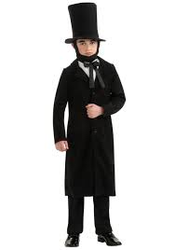
WAX MUSEUM BIOGRAPHIES
This engaging lesson in history could be used as a Halloween alternative.
In this activity, students research and prepare a brief speech about the life a famous person in history. They write their speech in the first person. Then they dress as the person they wrote about and present the speech they wrote.
This activity is a nice Halloween alternative, but it will engage students at any time of year. It might also be used as a fund-raising activity for October's parent open house. Students might hold a cup. When a parent puts a nickel in the cup, the student does their brief presentation for that parent. Use the money collected that night to fun a field trip for students or some other activity.

Slide 4
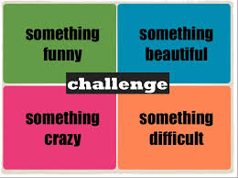
FOUR CORNERS
The "Four Corners" game is popular with teachers and students. It's simple to play, and it offers an opportunity for students to burn off some excess energy on a Friday afternoon. It's a fun activity to offer as a reward at the end of a week of hard work and excellent effort.
Number the corners of the classroom from 1 to 4.
Select one student to be It. That person closes his or her eyes while the rest of the students go to one of the four corners in the classroom.
When all students are settled in a corner, It calls out a number. All the kids who chose that corner are out of the game and must sit down.
It closes his or her eyes again, calls out a number, and more students sit down.
When the game gets down to four people or fewer, each must choose a different corner. If It calls out a corner where nobody is standing, It must choose again.
The game continues until only one student is left. That student becomes It.

Slide 5
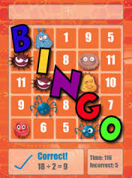
MATH BINGO
Use Education World's Math BINGO cards to play a game very much like regular BINGO. The link below will take you to instructions for using this game to reinforce many different math skills at a wide variety of grade levels. A printable Math BINGO card is included for use with the activity.

