Slide 1
MULTIVERSIDAD LATINOAMERICANA
CAMPUS: OAXACA URBANA
BACHILLERATO.
Materia: Inglés.

Slide 2
IRREGULAR ADJECTIVES.
POSITIVE FORM.
Bad
Far
Good
Little
Few
Many
Much
Old
COMPARATIVE FORM.
Worse
Farther or Further
Better
Less
Less
More
More
Older or Elder

Slide 3
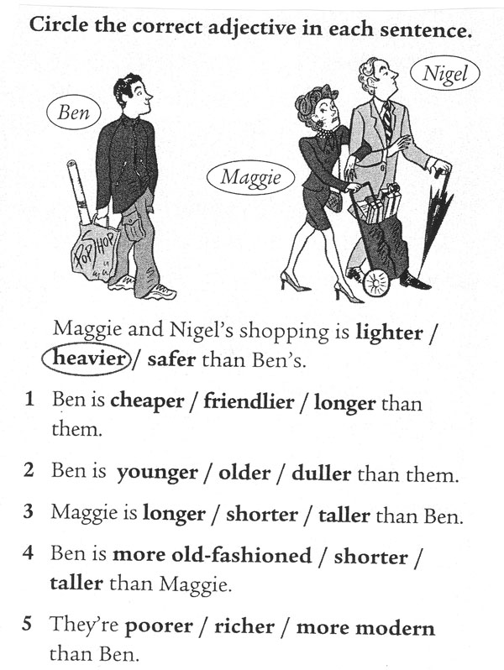

Slide 4

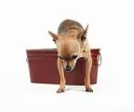
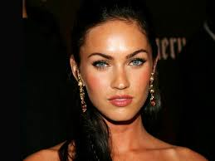
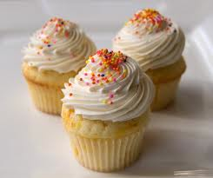
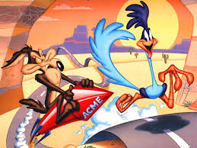
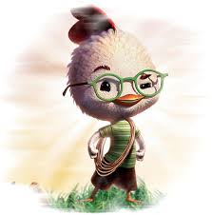
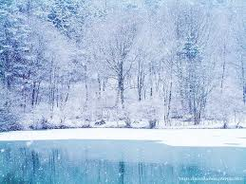
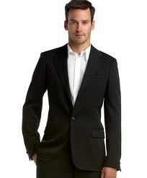

With the next adjectives make comparative sentences in your notebook.
Tiny.
Pretty.
Sweet.
Clean.
Good.
Fast.
Little.
Cold.
Formal.

Slide 5
Consulta internet:
http://www.dailywritingtips.com/comparative-forms-of-adjectives/
http://www.inglestotal.com/comparative-form/
http://www.oxforddictionaries.com/es/palabras/comparative-and-superlative-adjectives-american
http://www.k12reader.com/comparative-adjectives/
http://www.inglestotal.com/adjectives/
http://www.youtube.com/watch?v=V7oxnrsghto

