Slide 1
MULTIVERSIDAD LATINOAMERICANA
CAMPUS: OAXACA URBANA
BACHILLERATO.
Materia: Inglés.

Slide 2
Block. 1. i compare people, objects and places.
1.1 COMPARISIONS: EQUALITY AND INEQUALITY.
Equality: as…….as
much/many …….. as
Inequality:
not as ………as
not so ………as
less than
more than

Slide 3
WE CAN SHOW THAT TWO PEOPLE OR THINGS ARE EQUAL OR NOT EQUAL IN ONE WAY BY USING AN ADJECTIVE OR AN ADVERB.
WORDS WHICH ARE USED TO MODIFY NOUNS OR PRONOUNS ARE USUALLY REFERRED TO AS ADJECTIVES.
ADJECTIVES ARE USED TO DESCRIBE QUALITIES OR CHARACTERISTICS OF SOMEONE OR SOMETHING.

Slide 4

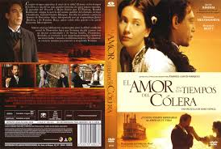
To form the comparisons of equality using adjectives or adverbs, use the following formula:
Noun + as + adjective/adverb + as + noun
Example:
The book is as good as the movie.

Slide 5


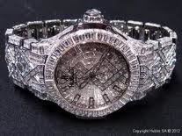
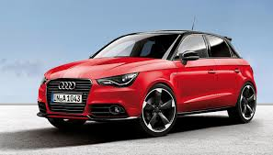
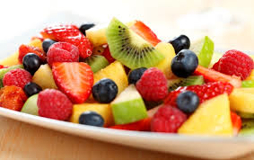
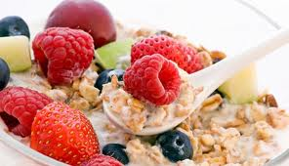
The flower is as beautiful as my mom.
This watch is as expensive as this car.
The restaurant’s cocktail of fruits is as delicious as my cereal’s mom.

Slide 6
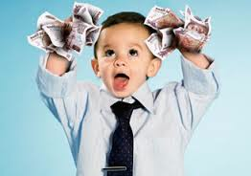
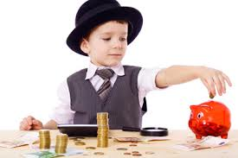
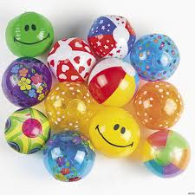
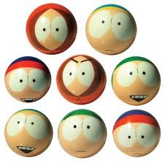
To form comparisons of equality with nouns, use the following formula:
Subject + have/has + As + much + noun + as + subject
MANY
Example:
Raul has as much money as Manuel.
Carlos and Marcos have as many balls as Pedro and Jorge.

Slide 7
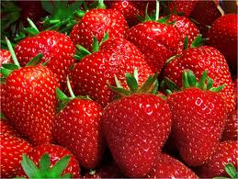
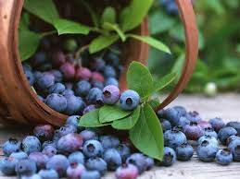
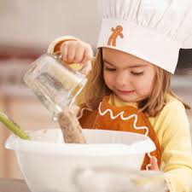
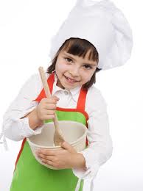
When actions (not things) are being compared, and there is no adjective, use the following formula:
Subject + verb s.p + as much + as + subject.
The strawberries cost as much as blueberries.
Samantha cooks as much as Perla.

