Slide 1
MULTIVERSIDAD LATINOAMERICANA
CAMPUS: OAXACA URBANA
BACHILLERATO.
Inglés I
BLOQUE II. DESCRIBO MIS ACTIVIDADES COTIDIANAS

Slide 2
LEISURE.
"Play is any activity that has great meaning but no purpose.” -- Mark Twain
Some consider leisure activities to be play and recreation. Leisure implies a less serious purpose without necessarily producing a product or skill. It implies joy, enthusiasm opportunity and energy.

Slide 3
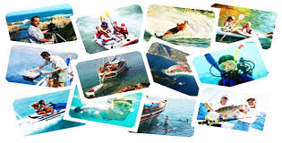

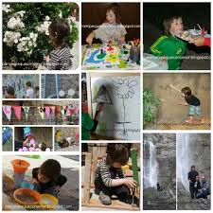
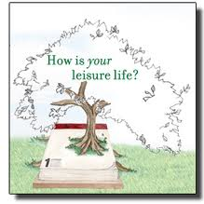
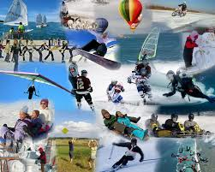

Slide 4
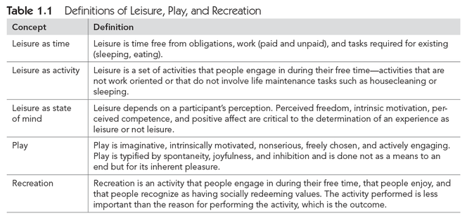

Slide 5
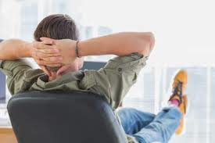
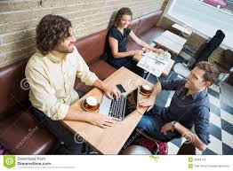
Definitions of leisure.
There is debate about how to define leisure. However, there is a general consensus that there are three primary ways in which to consider leisure: leisure as time, leisure as activity, and leisure as state of mind.
Leisure time is residual time.

