Slide 1

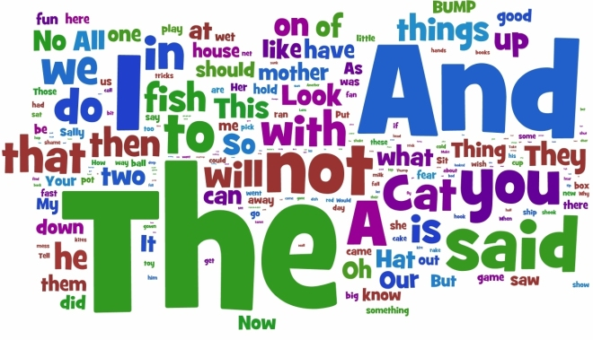
MULTIVERSIDAD LATINOAMERICANA
CAMPUS TONALÁ
INGLÉS II
BLOQUE III. SIGUE INSTRUCCIONES Y COMPRENDE REGLAMENTOS.
MAESTRO GABRIEL
ASCENCIO CASILLAS

Slide 2



GIVING ORDERS AND INSTRUCTIONS IN ENGLISH
*Orders
*Warnings
*Advice
*Requests

Slide 3



ORDERS.
Adults do not usually give each other orders, unless they are in a position of authority, examples;
“COME HERE! “
“SIT!”
“FETCH!”

Slide 4


WARNINGS
You can use an imperative to warn someone of danger.
“WATCH OUT!”
“LOOK OUT!”
“DON’T CROSS”

Slide 5


ADVICE
You can express advice using imperative…
“EAT AN APPLE – IT’S MUCH BETTER FOR YOU THAN A BISCUIT”
“DON’T TELL HIM YET! HE’S ANGRY NOW”

Slide 6
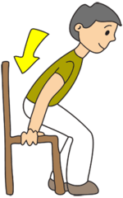
REQUESTS
You can use an imperative form to make a request…
“PLEASE TAKE A SEAT”
“PLEASE WAIT HERE”
“PLEASE DON’T TURN OFF THE LIGHT”

Slide 7

NOW LET’S PRACTICE…
Complete the sentences in affirmative or negative using the following verbs…
.CHOOSE .HAND IN .USE .BRING .WRITE
a) ______ your answers with clear andwriting.
b) ______ the cell phone in class.
c) ______ your assignments on time.
d) ______ your books to clase.
e ) ______ the best option .

