Slide 1
Multiversidad Latinoamericana
SUBJECT: InglÉs iv
TOPIC: Present Perfect Continuous – Use
CAMPUS: DURANGO
SEMESTER: 4
Prof.: silvestre jonattan RIVAS terrones
ONBJECTIVE: students will learn the different situations in which they can use the present perefect continuous tense, and how to create sentences using that tense.
25/03/2015

Slide 2
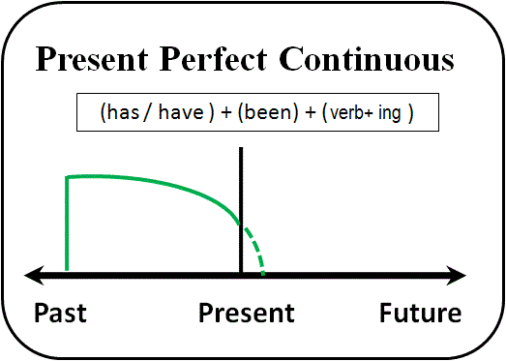
We use the present perfect continuous for an action over a period of time leading up to the present. It refers to an unspecified time “between now” and “now”.
We are interested in the action as well as the result, and this process may still be going on, or may have just finished.

Slide 3
Expamples
1. Actions that started in the past and continue in the present.
* We have been waiting for the package all day (and we are still waiting now).
*Margaret is tired. She has been working all day on her final paper (and she is still working on it, because she hasn´t finished it yet).
*Mike and Jack have been studying since 6 o´clock (and haven´t finished yet).

Slide 4
2. Actions that have just finished, but we are interested in the results:
* It´s been raining since midday (and the streets are still wet).
*I´ve been Reading all afternoon. I´ve just finished the book.
*Who´s been using my computer? (I turned it off and it is on now.)

Slide 5
You can use the present perfect continuous WITHOUT a duration such as “for five minutes,” “for two weeks,” and “since Tuesday.” Without the durations, this tense gives a more general meaning of “lately”. We often use the words “lately” or “recently” in the sentence to strengthen this meaning.

Slide 6
Examples:
Recently, I have been feeling really tired.
She has been watching too many science fiction movies lately.
Terry has been feeling a Little depressed.

Slide 7
Special Note
Verbs Without Continuous Forms
With verbs not normally used in the continuous form, use the present pefect simple. Some of these verbs are: want, know, love, hear, see, understand, taste, among others.

Slide 8
Examples:
*I´ve wanted to visit Paris for years.
*Betty has known Fred since they were in elementary school.
*I´ve loved that music snce I first heard it.
*I´ve Heard a lot about you recently.
*We´ve understood everything we´ve heard this morning.

Slide 9
EXCERCISE
COMPLETE THE SENTENCE USING THE VERBS ON THE PARENTHESIS.
Robin: I think the waiter (forget) us. We (wait) here for over half an hour and nobody (take) our order yet.
Michele: I think you're right. He (walk) by us at least twenty times. He probably thinks we (order, already)
Robin: Look at that couple over there, they (be, only) here for five or ten minutes and they already have their food.
Michele: He must realize we (order, not) yet! We (sit) here for over half an hour staring at him.

Slide 10
Video De Presente Perfecto Continuo
https://www.youtube.com/watch?v=9vj5hNmQamU

