Slide 1




ENGLISH 101
Block I: Who are you ?
Teacher Gerardo Cano Grupo 101 CAMPUS LEÓN 4 Septiembre 2015

Slide 2
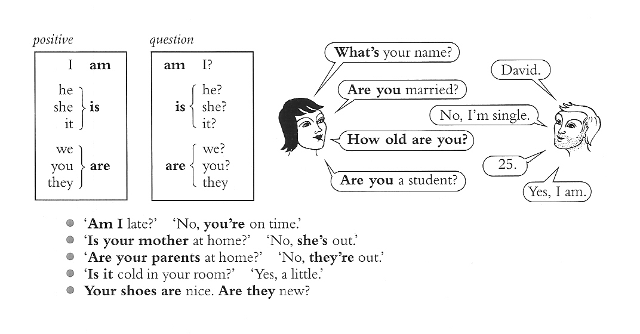
Verb “to be”

Slide 3
“A Sky full of Stars”
'Cause ______ a sky, cause ______a sky full of stars
______ gonna give you my heart
'Cause you're a sky, cause you're a sky full of stars
'Cause you light up the path
I ______ care, go on and tear me apart
I _______care if you ______
'Cause in a sky, cause in a sky full of stars
I ______ I saw you

Slide 4
‘ Cause you're a sky, cause you're a sky full of stars
I _______ to die in your arms, arms
'Cause you ______lighter the more it _______ dark
I'm going to give you my heart
And I don't care, go on and tear me apart
And I don't care if you do
'Cause in a sky, cause in a sky full of stars
I think I see _______
I think I see _______
Because you're a sky, you're a sky _____of stars
Such a heavenly view
________ such a heavenly view
Performed by Cold Play

Slide 5
Fill in the blanks from the activity above, please use the following vocabulary.
- You’re – - I’m – - want - - full -
- Do - - I don’t - - get -
- think - - gets - - you -

