Slide 1
MULTIVERSIDAD LATINOAMERICANA
CAMPUS: OAXACA URBANA
BACHILLERATO.
Inglés I
BLOQUE II. DESCRIBO MIS ACTIVIDADES COTIDIANAS

Slide 2
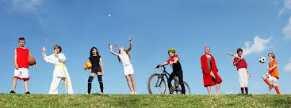

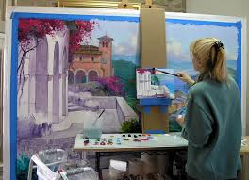
Leisure as activity encompasses the activities that we engage in for reasons as varied as relaxation, competition, or growth and may include reading for pleasure, meditating, painting, and participating in sports.

Slide 3

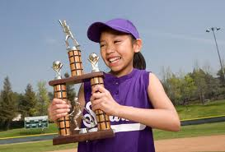
Leisure as State of mind.
Concepts such as perceived freedom, intrinsic motivation, perceived competence, and positive affect are critical to determining whether an experience is leisure or not leisure.
What may be a leisure experience for one person may not be for another; whether an experience is leisure depends on many factors.
Enjoyment, motivation, and choice are three of the most important of these factors.

Slide 4
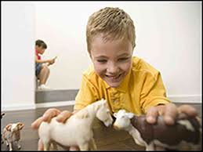
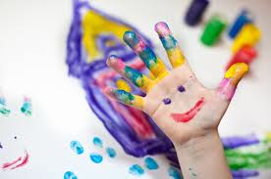
Play.
While most people see play as the domain of children, adults also play, although often their play is more entwined with rules and regulations, which calls into question how playful their play really is.

Slide 5
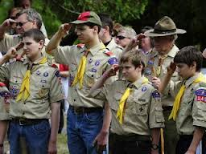
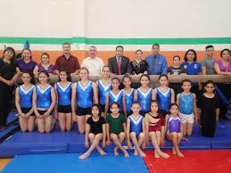
Recreation.
Examples of recreational activities are endless and include sports, music, games, travel, reading, arts and crafts, and dance.
Participants hope that their recreation pursuits can help them to balance their lives and refresh themselves from their work as well as other mandated activities such as housecleaning, child rearing, and so on.

Slide 6
Bibliography:
Definitions of leisure, play, and recreation
This is an excerpt from The Park and Recreation Professional’s Handbook by Amy R. Hurd and Denise M. Anderson
http://www.humankinetics.com/excerpts/excerpts/definitions-of-leisure-play-and-recreation
Activity and Leisure.
http://cas.umkc.edu/casww/sa/activity.htm

