Slide 1
MULTIVERSIDAD LATINOAMERICANA
CAMPUS: OAXACA URBANA
BACHILLERATO.
Inglés I
BLOQUE III. DESCRIBO LO
QUE ESTÁ SUCEDIENDO.
L.R.I. ANAID LUNA GARCÍA

Slide 2
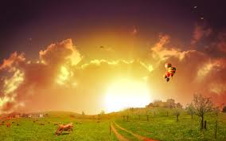
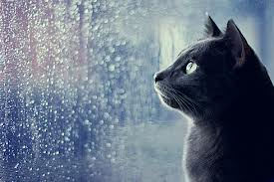
weather.
NOUNS
ADJECTIVES
SUN/SUNSHINE
SUNNY
RAIN
RAINY

Slide 3
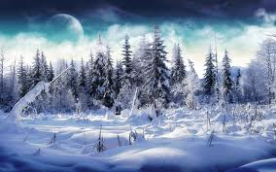
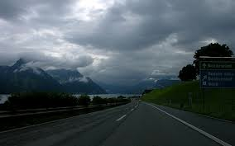
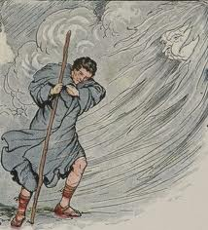
SNOW
SNOWY
CLOUD
CLOUDY
WIND
WINDY

Slide 4
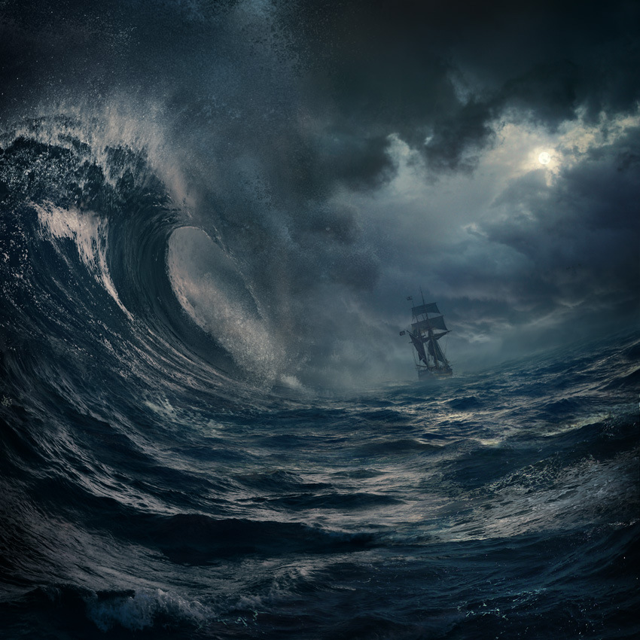
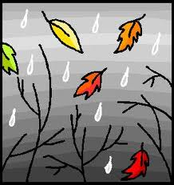

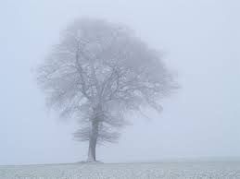
STORM
STORMY
DRIZZLE
DRIZZLY
BREEZE
BREEZY
FOG
FOGGY

Slide 5
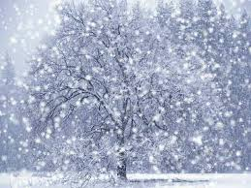
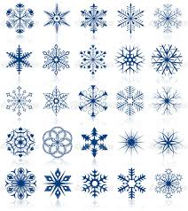
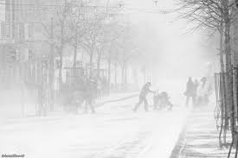


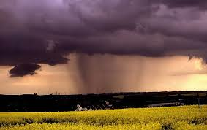
WORDS RELATED TO SNOW (NOUN)
snowfall
snowflake
snowstorm
WORDS RELATED TO RAIN (NOUNS)
raindrop
rainfall
SHOWER

Slide 6
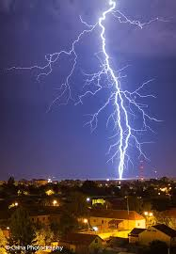
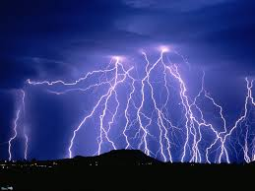
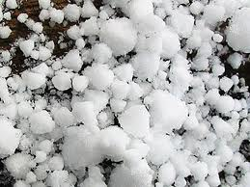
thunder
thunderstorm
hail

Slide 7
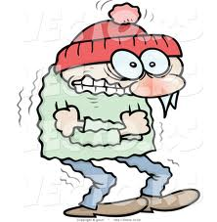
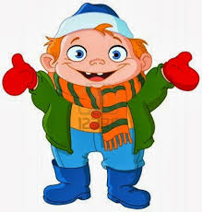
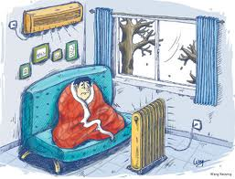
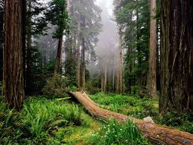
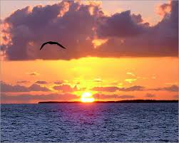
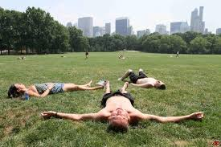
ADJECTIVES THAT DESCRIBE THE TEMPERATURE
FREEZING
COLD
CHILLY
MILD
WARM
HOT

Slide 8
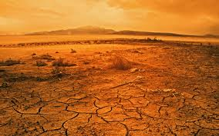
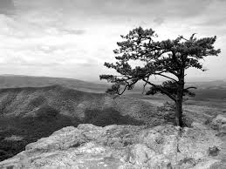
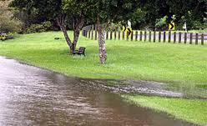
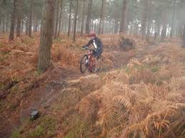
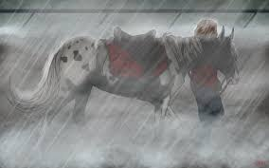
ADJECTIVES USED TO DESCRIBE WEATHER.
DRY
dull
wet
damp
miserable

