Slide 1
MULTIVERSIDAD LATINOAMERICANA
CAMPUS: OAXACA URBANA
BACHILLERATO.
Materia: Inglés.

Slide 2


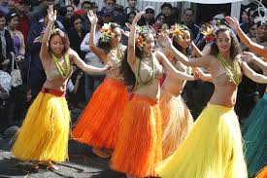

The construction as, followed by and adjective, followed by as can also be combined with a noun.
SUBJECT + TO BE + AS + ADJECTIVE + NOUN + AS + SUBJECT
EXAMPLE:
EDUARDO IS AS SMART A STUDENT AS FRANCISCO.
THAT GIRLS ARE AS BEAUTIFUL WOMEN AS MY FRIENDS.

Slide 3
AS + POSITIVE FORM OF ADJECTIVE + A/AN + SINGULAR COUNTABLE NOUN + AS
SANDY IS A GOOD FRIEND.
LIZETH IS A GOOD FRIEND TOO.
SANDY IS AS GOOD A FRIEND AS LIZETH
IN THE CASE OF PLURAL NOUNS, NO ARTICLE IS REQUIRED.
ALEJANDRO AND LUIS ARE POWERFUL ATHLETES.
THEIR COMPETITORS ARE POWERFUL TOO.
ALEJANDRO AND LUIS ARE AS POWERFUL ATHLETES AS THEIR COMPETITORS.

Slide 4
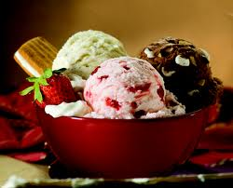
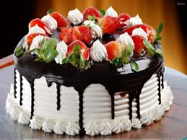


In the Inequal comparisons we can use
not as…as or not so…as.
The ice cream is not as tasty as a cake.
Andres doesn’t read so many books as Miguel does.

Slide 5
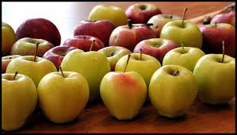
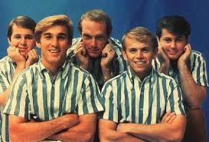
Inequality.
To form comparisions of inequality we can use the next formula:
More than………
Subject/ there + verb to be + more than + number + noun.
There are more than sixteen apples in the table.
They are more than thirty years old.

Slide 6


Less than……….
Subject + verb to be + less than + number + noun.
There are less than twenty roses.
She is less than fourty years old.

Slide 7
Bibliografía:
Flores Paula, Urquijo Katherine., Bachillerato General English 2., Ed. Patria., 2009., México.
Consulta en internet:
http://www.studyspanish.com/lessons/equal.htm
http://www.englishpractice.com/improve/talking-equality-inequality/

